Slide 1
DR SNSRCAS, CBE Software Engineering 21UCA408 II BCA B UNIT II Requirements Analysis

Slide 2
Requirements Analysis
Every new software product or service developed in any corporation is in response to a business requirement. Despite spending significant time and money on the development, there may be a mismatch between the needed product (according to the business requirement) and the final result. Hence, to avoid severe problems in the future, a focused and complete requirements analysis is required in the early stages of every project. The process of determining the needs and expectations of a new product is known as 'requirements analysis' or 'requirements engineering'. It entails continuous communication with the product's stakeholders and end-users to set expectations, manage issues, and document all critical needs.

Slide 3
Requirements Analysis
Every new software product or service developed in any corporation is in response to a business requirement. Despite spending significant time and money on the development, there may be a mismatch between the needed product (according to the business requirement) and the final result. Hence, to avoid severe problems in the future, a focused and complete requirements analysis is required in the early stages of every project. The process of determining the needs and expectations of a new product is known as 'requirements analysis' or 'requirements engineering'. It entails continuous communication with the product's stakeholders and end-users to set expectations, manage issues, and document all critical needs.

Slide 4
Requirements Analysis
What is Requirement Analysis in Software Engineering?
The process of defining user expectations to build a new software product or to modify an existing one is known as requirement analysis, sometimes known as requirement engineering requirements gathering, or requirements capture in software engineering. The tasks that go into determining the needs or conditions to meet for a new or altered product, taking into account the potentially conflicting requirements of the various stakeholders, and analyzing, documenting, validating, and managing software or system requirements are all included in requirements analysis.

Slide 5
Requirements Analysis
This exercise goes over all of the requirements and may provide a graphical representation of the entire system. As a result, the project's understandability is predicted to improve significantly after the study is completed. We may also leverage the contact with the customer to clear up any confusion and determine which requirements are more crucial than others.

Slide 6
Requirements Analysis
Steps Involved in Requirement Analysis
Step 1: Recognize the Problem
The primary goal of requirement analysis is to thoroughly grasp the main objective of the requirement, which includes why it is needed, whether it adds value to the product, whether it will be beneficial, whether it will raise the quality of the project, and whether it will have any other effect. These factors are appropriately acknowledged in this step so that fundamental requirements for solving business problems can be met.
Step 2: Evaluation and Synthesis
Evaluation is to decide whether something is valuable or not, and synthesis means to build or develop anything. The following tasks are critical in the evaluation and synthesis stage of requirements analysis (not an exhaustive list):

Slide 7
Requirements Analysis
To define all software functions that are required.
To define all data objects that are visible to the outside world.
To determine whether or not a data flow is valuable.
To thoroughly comprehend the whole behaviour of the system, that is, the overall operation of the system.
The system interface must be defined and established to fully comprehend how the system communicates with two or more components or with one another.
To find and discover designed constraints.

Slide 8
Requirements Analysis
Step 3: Modelling the Requirements
This step typically includes graphical representations of the functions, data entities, external entities, and their relationships. The visual perspective may aid in discovering inaccurate, inconsistent, missing, or excessive requirements. Data flow diagrams, entity-relationship diagrams, data dictionaries, state-transition diagrams, and other models fall under this category.
Step 4: Specification
We have a better knowledge of the system behaviour after modelling the requirements. Inconsistencies and ambiguities have been recognized and resolved. The data flow between modules has been examined. The actions of elicitation and analysis have generated a greater understanding of the system. We have completed the needs analysis in the previous steps, and in this step, we document these requirements in the SRS (Software Requirements Specification) document.

Slide 9
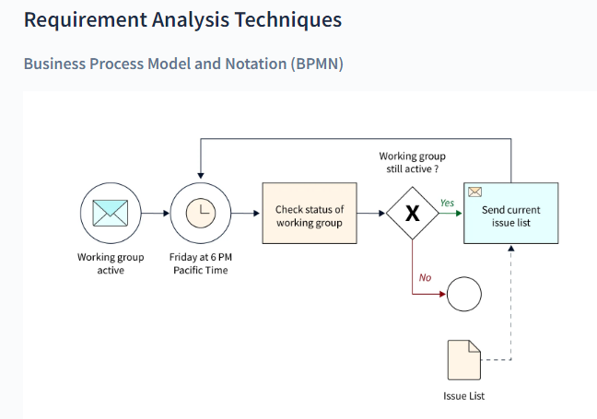
Requirements Analysis
Step 5: Review
After creating the SRS, it must be reviewed to see if it can be enhanced and polished to make it better and higher in quality.

Slide 10
Requirements Analysis
The Business Process Model and Notation are used to generate graphs that aid in the understanding of business processes. It is a common strategy used by business analysts to coordinate the sequence of messages between various participants in a linked set of activities.

Slide 11
THANK YOU

